Slide 1
SCIENCE AND OUR FOOD SUPPLY
LAB EXPERIMENT RESULTS

Slide 2
BACTERIA EVERYWHERE
Hypothesis: Bacteria is everywhere
Implications: Bacteria will grow if it has nutrients. If it is bad bacteria, it can then cause food poisoning if it is growing in our food.

Slide 3
Let’s try that experiment!

Slide 4
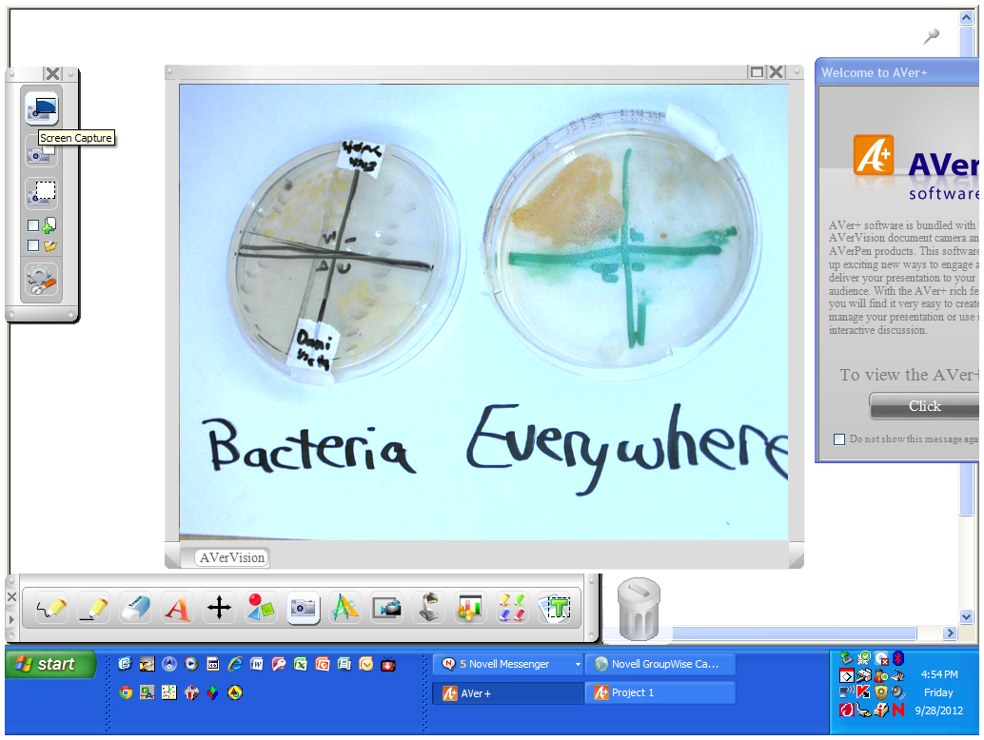

Slide 5
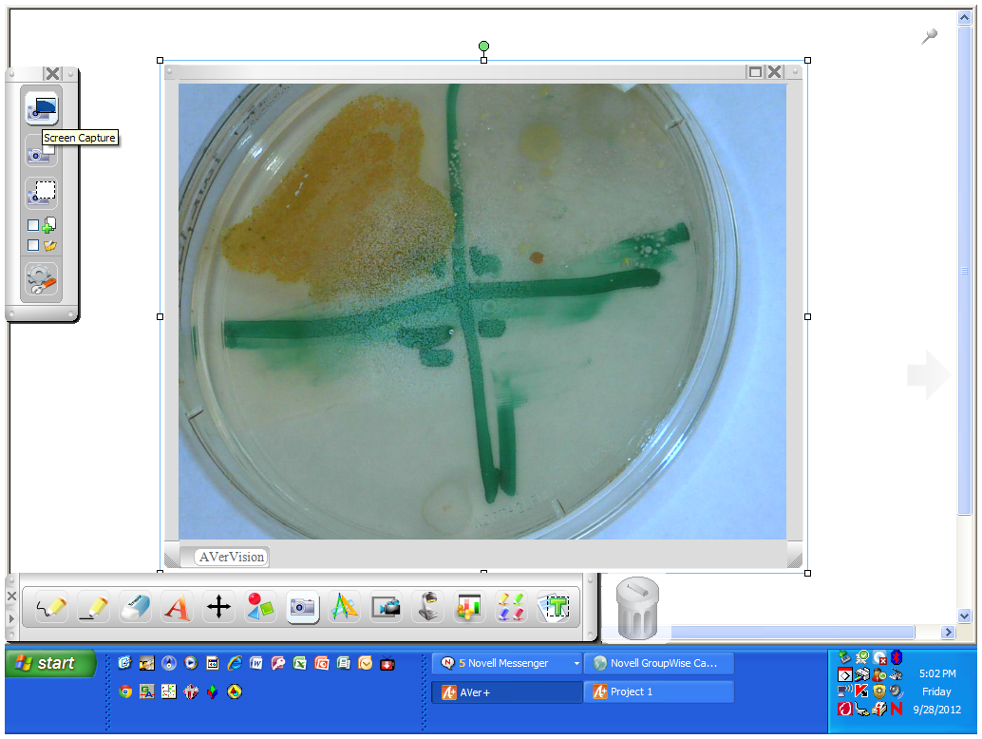
DAY 3

Slide 6
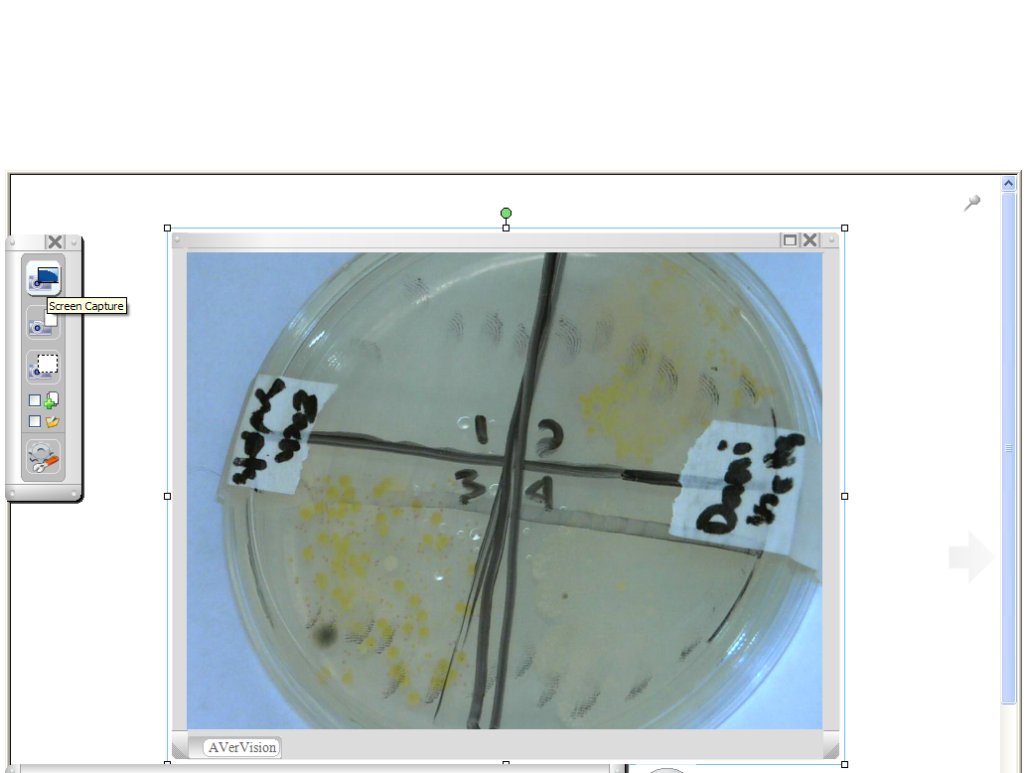

Slide 7
BLUES CLUES
Hypothesis: Milk left at room temperature will grow bacteria faster.
Question: Which milk (regular, pasteurized) or UHT (ultra high temperature) will produce less bacteria at room temperature?
Implications: Food should be kept at cold temperatures to reduce bacterial growth.

Slide 8
Let’s try that experiment!

Slide 9
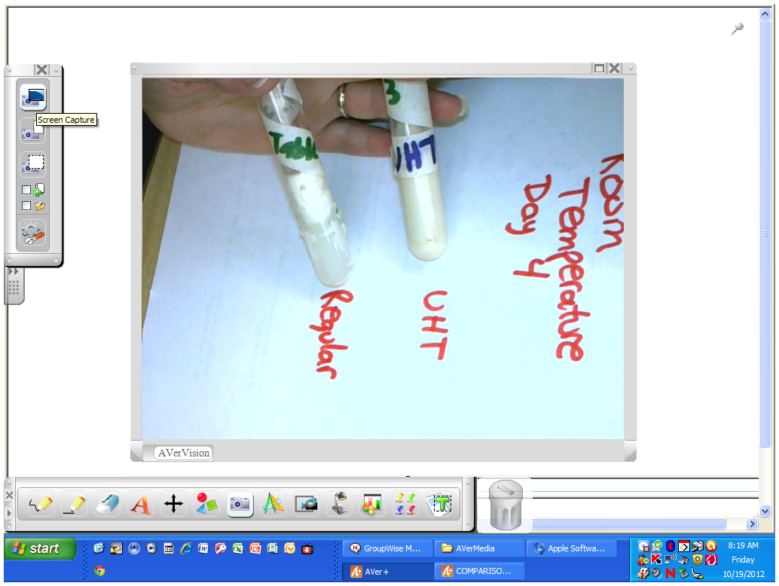
Room Temperature Day 4

Slide 10
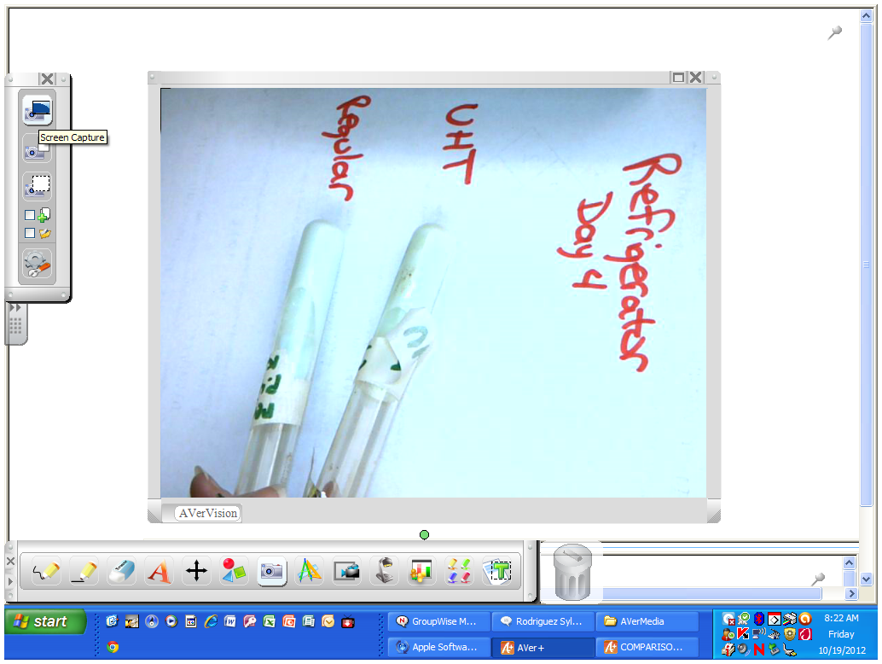

Slide 11
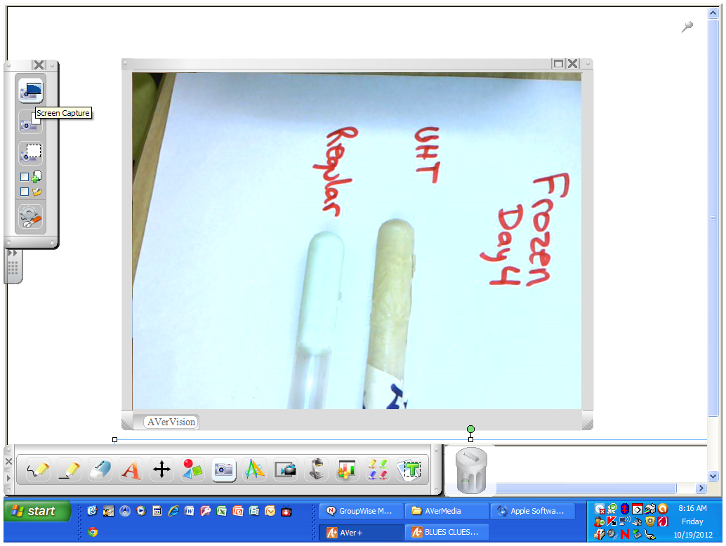

Slide 12
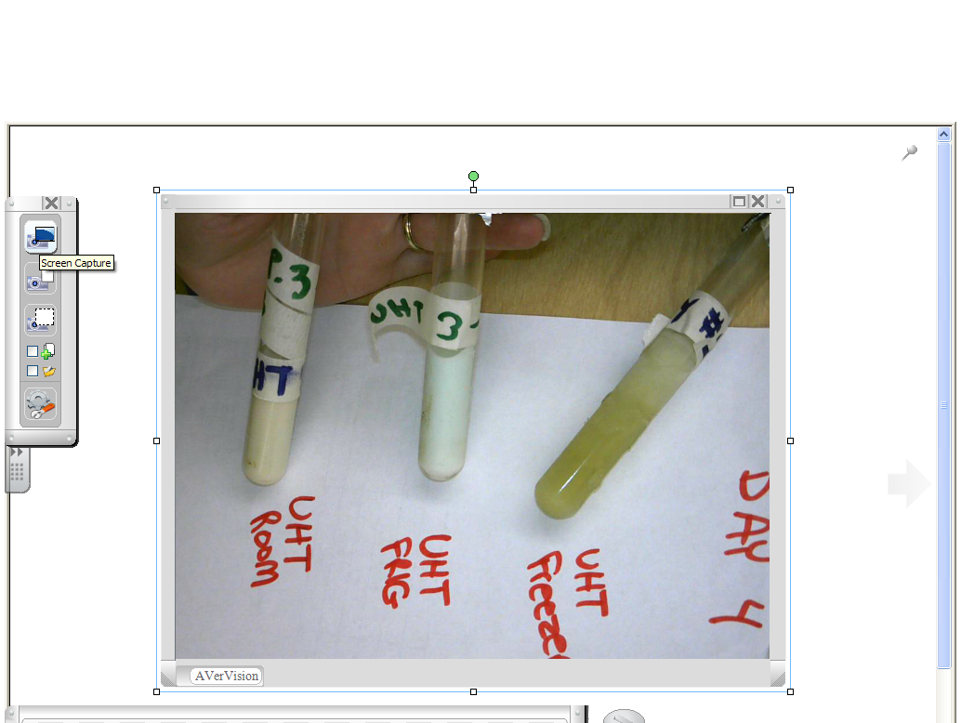

Slide 13
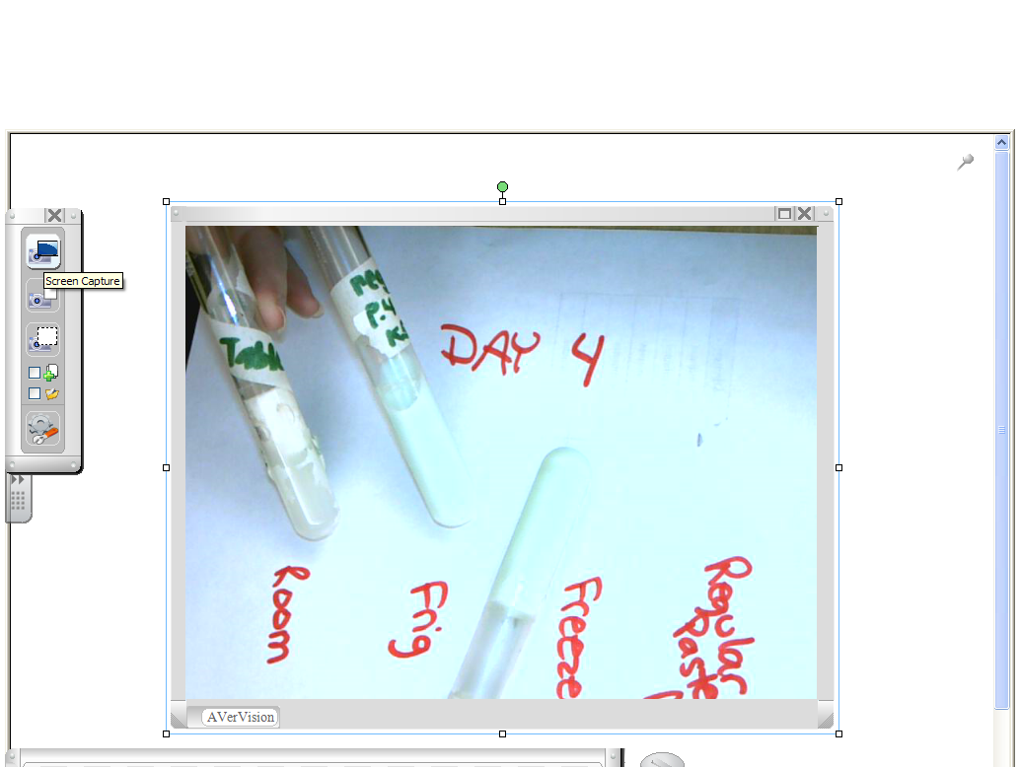

Slide 14
My students kept thinking UHT was unpasteurized milk. Most of them hypothesized that it would grow more bacteria.
I did try to get unpasteurized milk to show a difference. I was unable to get any in this area.

Slide 15
CHILLING INVESTIGATION
Hypothesis: Food left out at room temperature grows more bacteria than food left in the refrigerator.
Question: Students saw this relationship with milk, will it transfer to other foods?
Implications: Food not properly chilled (perhaps at a picnic?) raise the risk of food poisoning.

Slide 16
Let’s try that experiment!

Slide 17
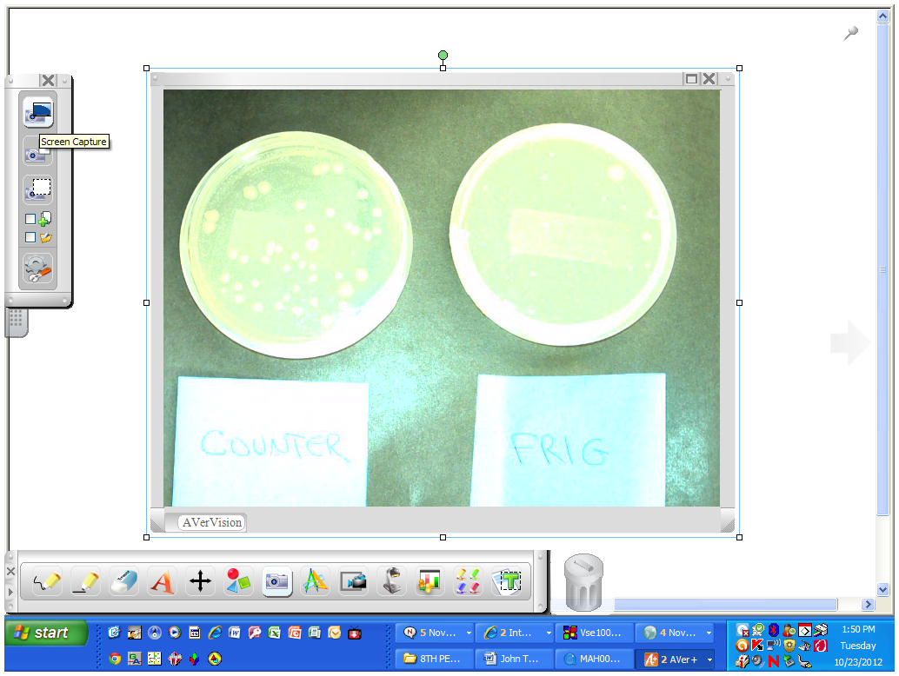

Slide 18
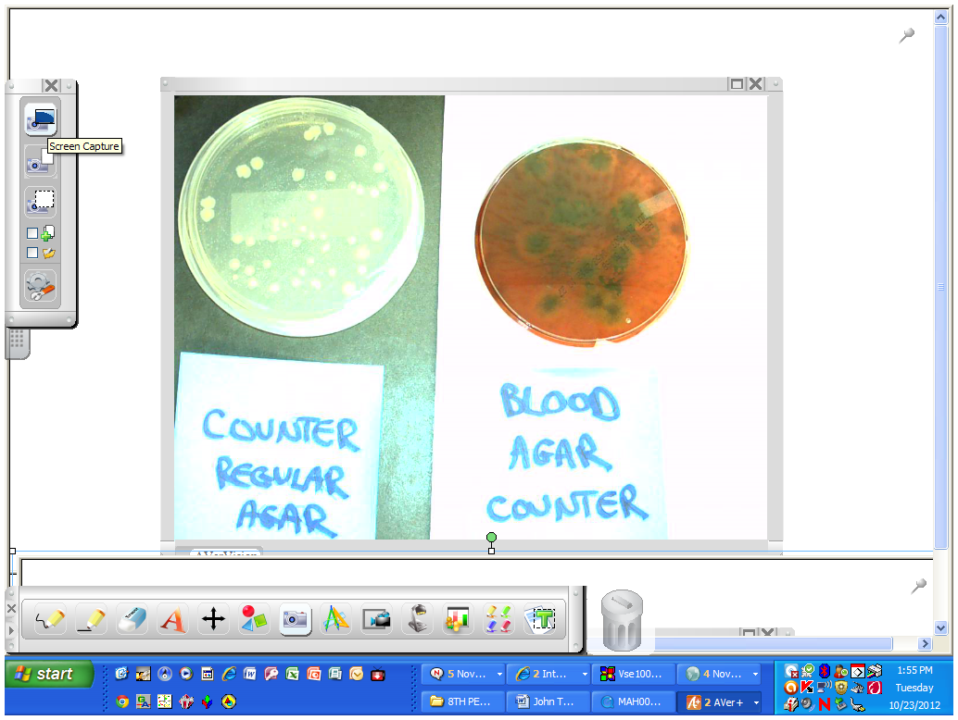

Slide 19
COOKING RIGHT
Hypothesis: The higher the temperature hamburger meat is cooked, the less chance of food poisoning.
Question: How do you order your hamburger? Medium well? Well done?
Implications: The really only safe temperature is 160, which is well done.

Slide 20
Let’s try that experiment!

Slide 21
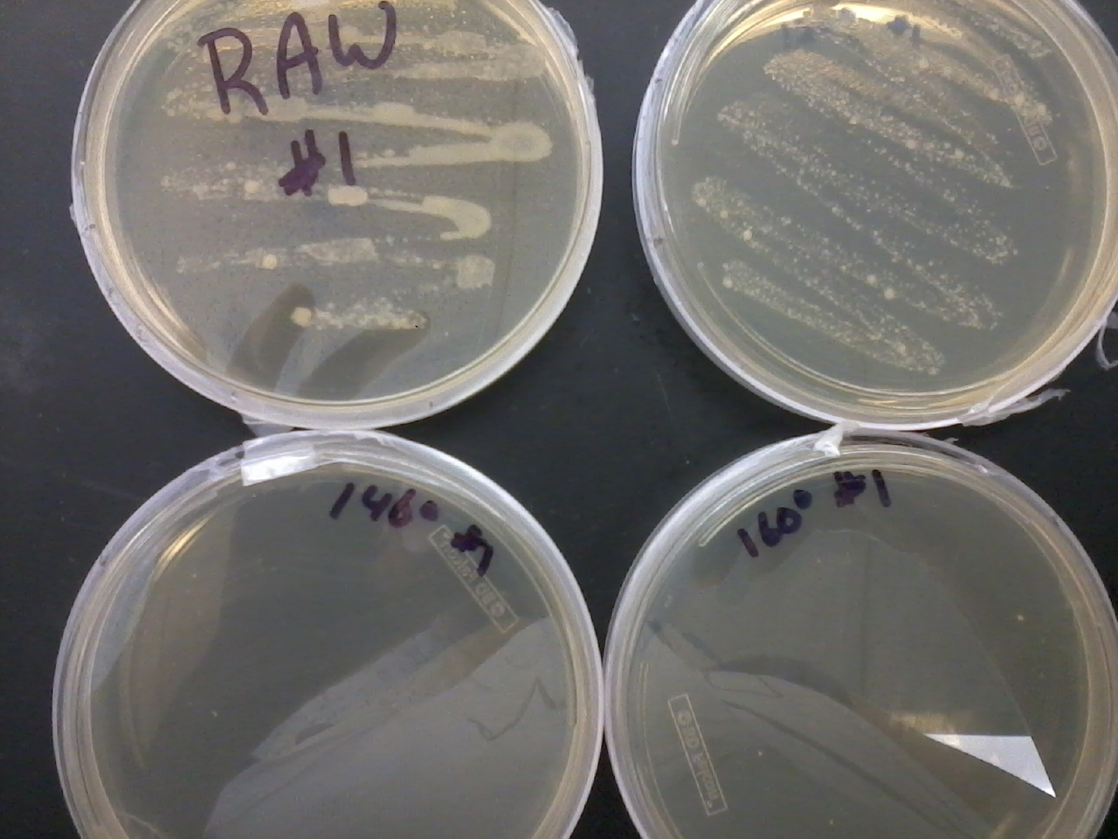

Slide 22
MYSTERY JUICE
Question: Which juice is safe to drink?
Hypothesis: My students made judgments based on clearness of liquid or odor.
Implications: You cannot tell by looking at food if it has harmful bacteria or not.

Slide 23
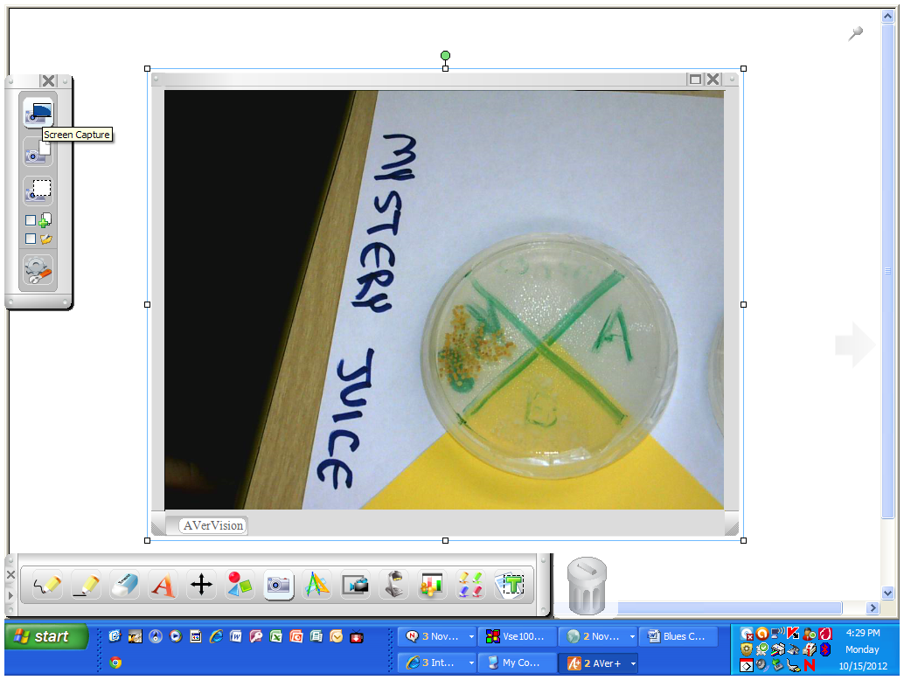

Slide 24
After seeing the result of Mystery Juice, my students wondered what the results would be if the apples had been washed….

Slide 25
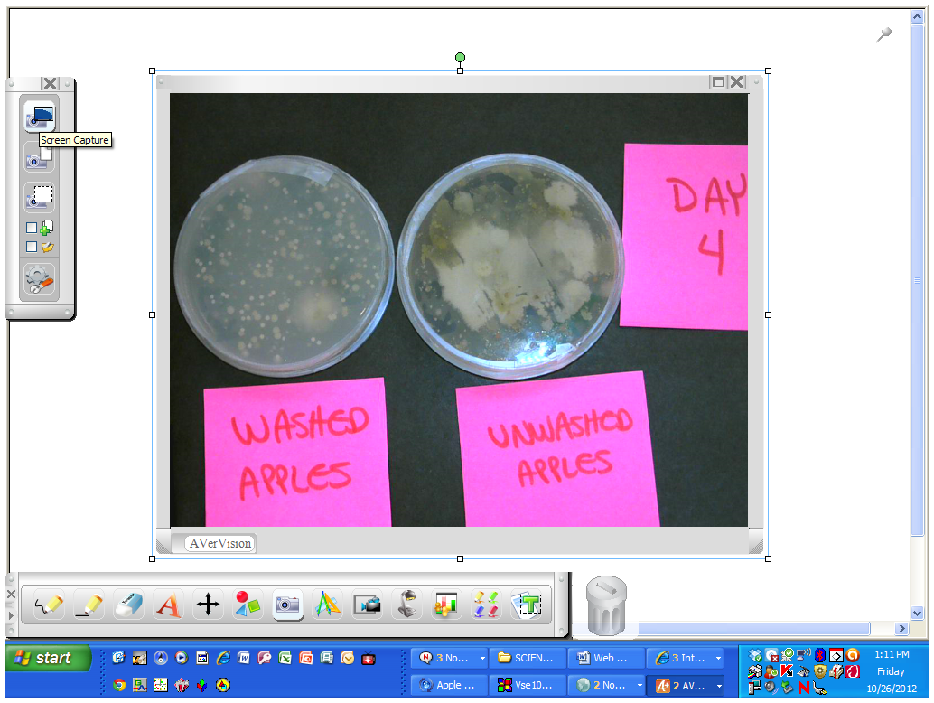

Slide 26
COLIFORM COUNTS
Advanced Level or Honors Biology
Testing for presence of coliforms is one way food scientists check for possible contamination. If their presence is detected (indicating food has been contaminated with fecal material), then proper precautions need to be taken (proper heating temperature).
One gram of hamburger can have 100,000-10,000,000 coliforms.
Experiment shows bacteria count of different dilutions of hamburger meat in saline solution.

Slide 27
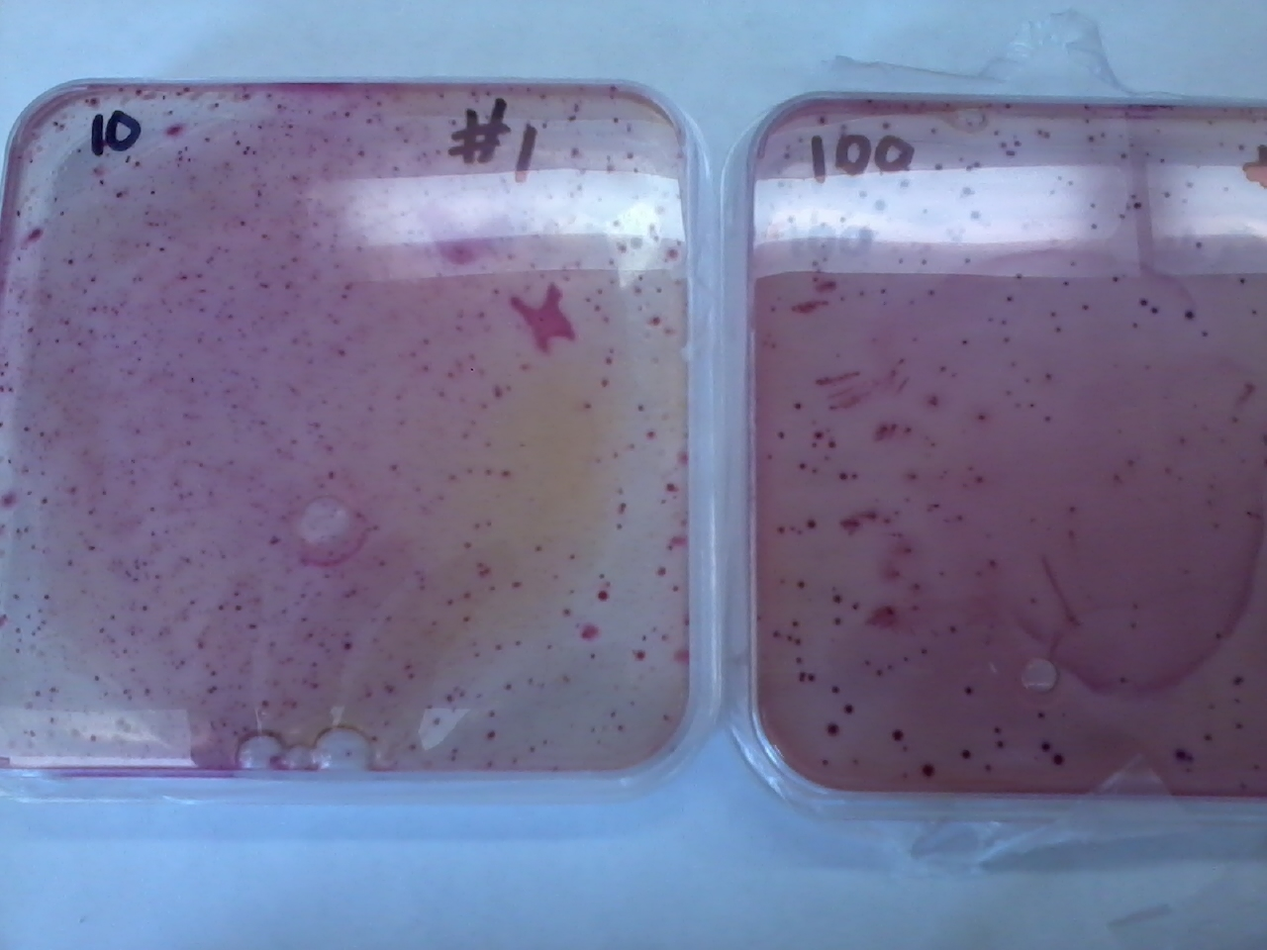
10 and 100 Dilution

Slide 28
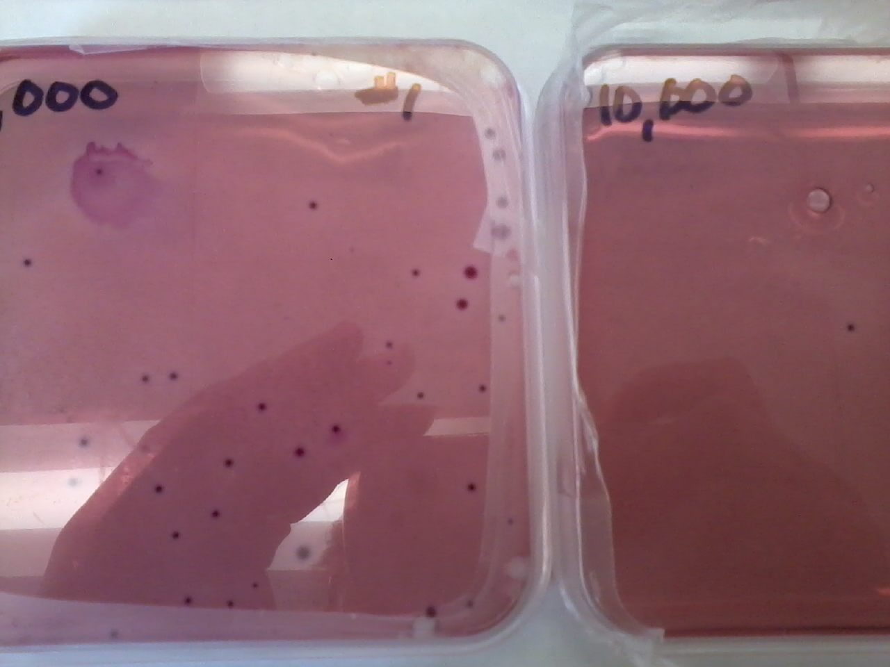
1,000 and 10,000 Dilution

Slide 29
DON’T CROSS ME
Hypothesis: The cheese that touches the board with the raw meat will have more bacteria than the cheese that touches the board that was washed.
Implications: Cross contamination can happen very easily.
My students finally understood the reason for a red and green cutting board.

Slide 30
Let’s try that experiment!
DON'T CROSS ME LAB PROCEDURES

Slide 31
